Slide 1


Final Presentation
DG4 – TIP – Batch9BD

Slide 2
Introduction
Mentor: Dung Vo, Hung Mai, Long Nguyen
Intern: Viet Pham, Tien Do, Hau Nguyen, Tuan Vo, Tai Dang

Slide 3
Content
Introduction technology use in project
Results learnt & apply to project
Demo project

Slide 4
Introduction Technology

Slide 5

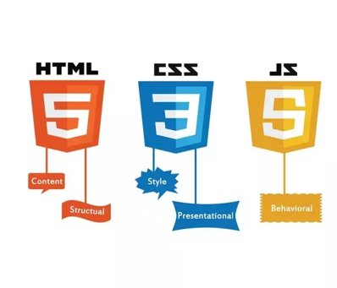


Technology

Slide 6
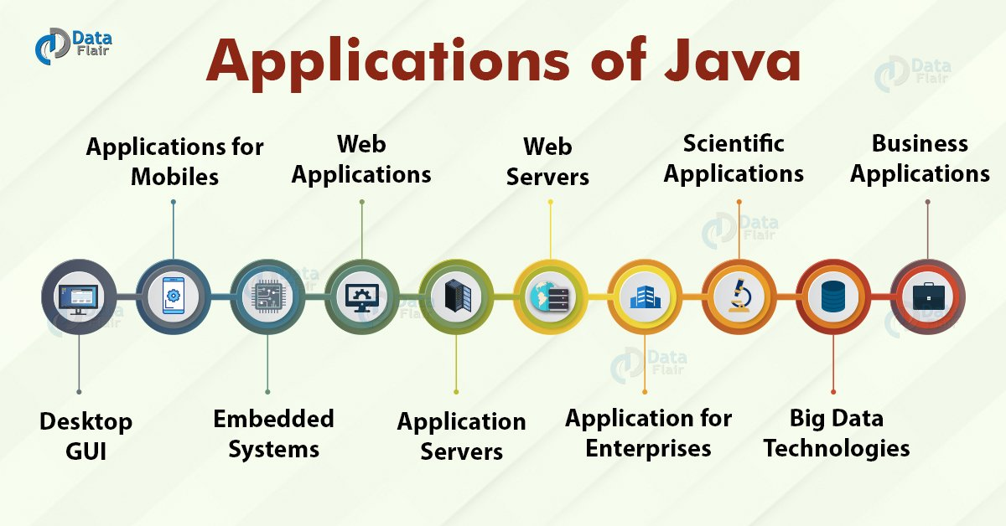

Slide 7
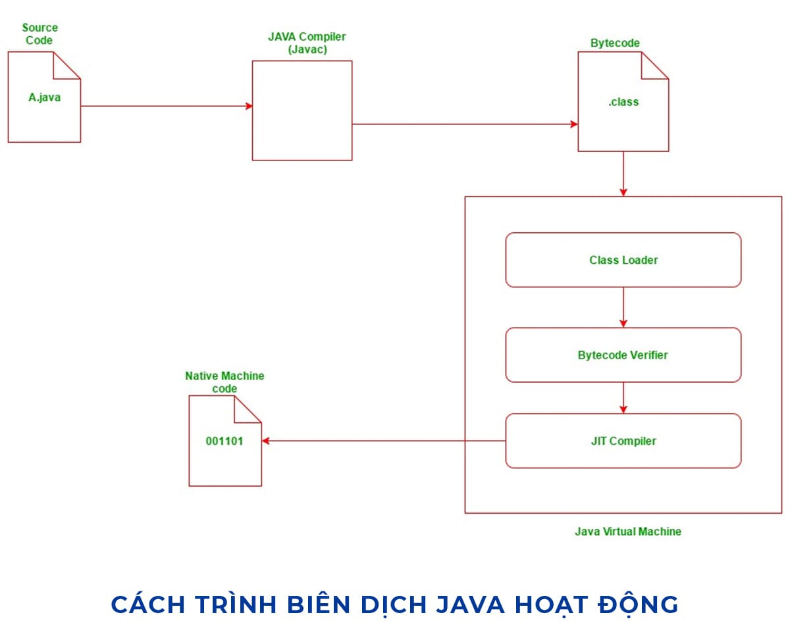
JAVA Working

Slide 8
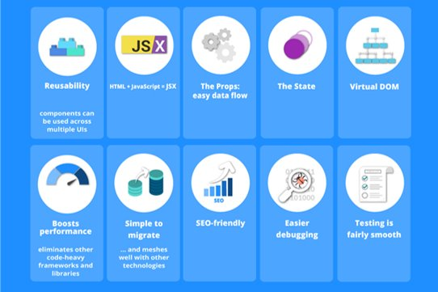

ReactJS

Slide 9

ReactJS Working with API

Slide 10
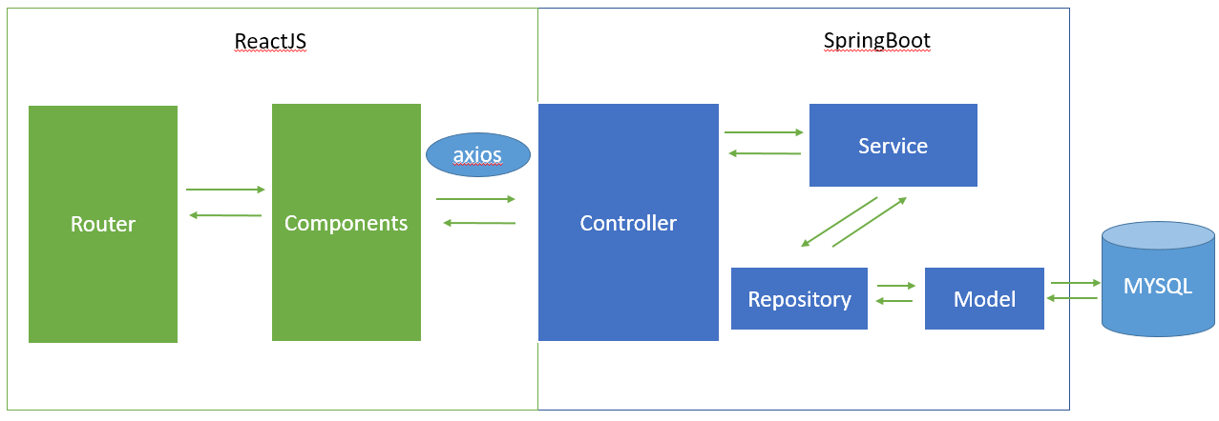
Operation Model

Slide 11
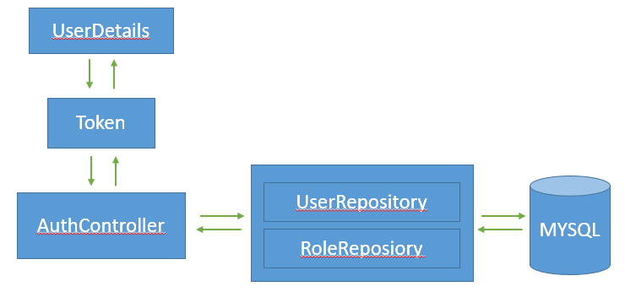
Spring Security

Slide 12
Results Learnt & Apply to project

Slide 13

Results learnt
Code Style & Optimize code
Design UI
Git, Gitlab, GitHub,Trello
MySql
Database
Spring Boot
ReactJS

Slide 14
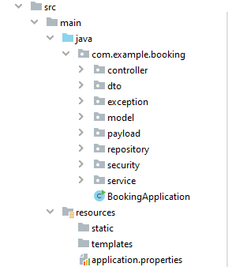
Project Folder(Java Spring)

Slide 15
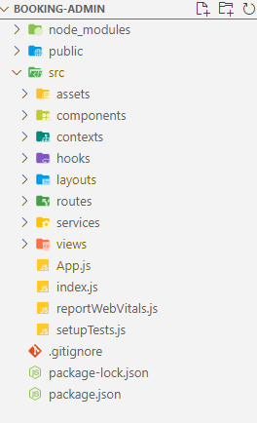
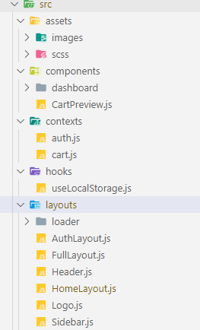
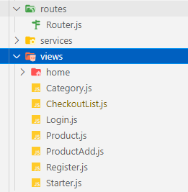
Project Folder (ReactJS)

Slide 16
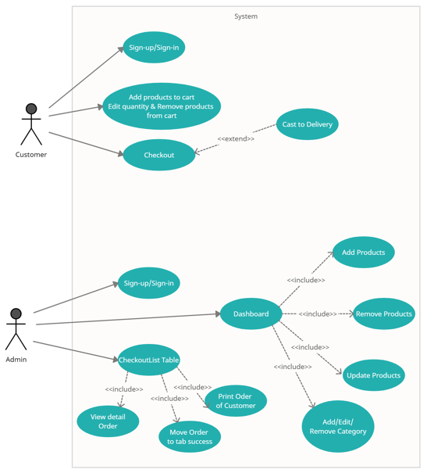
UC Diagram

Slide 17
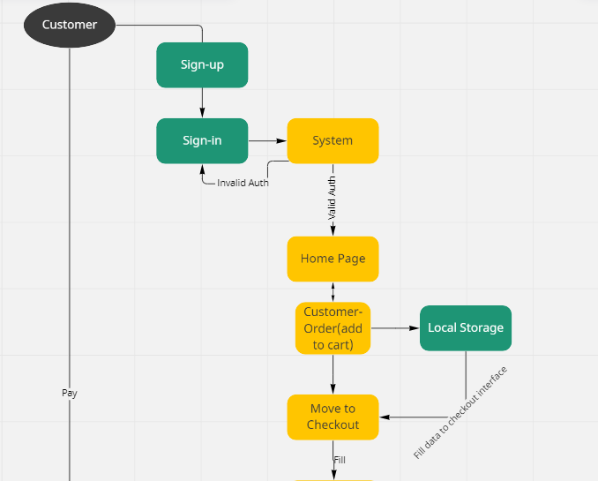
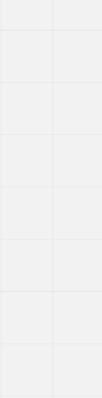
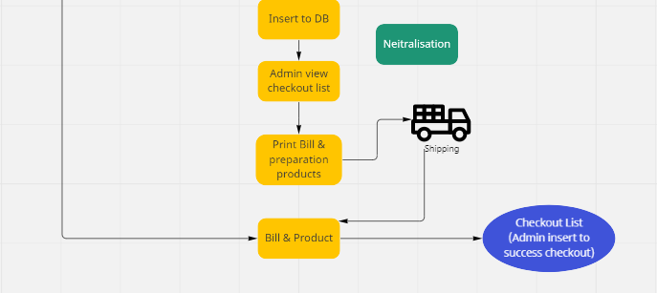
Activity Diagram

Slide 18
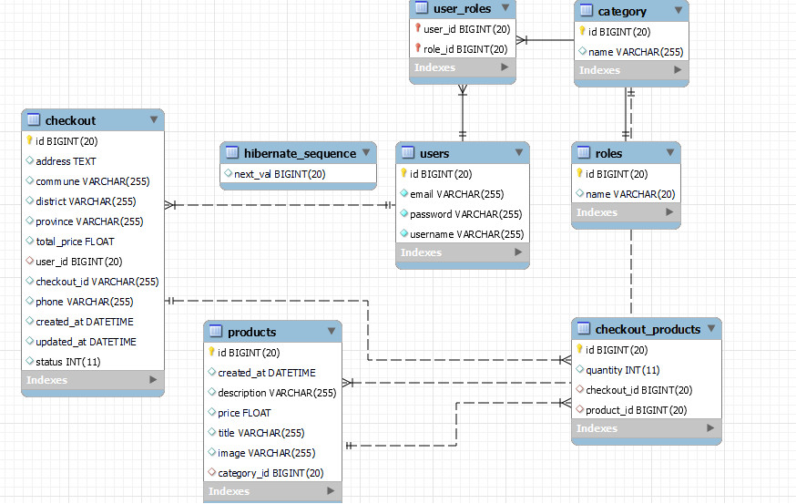
ERD

Slide 19
Project Overview
Customer page display list product and view details.
Customer can add product to cart and checkout.
Admin page to manage products & checkoutlist.

Slide 20
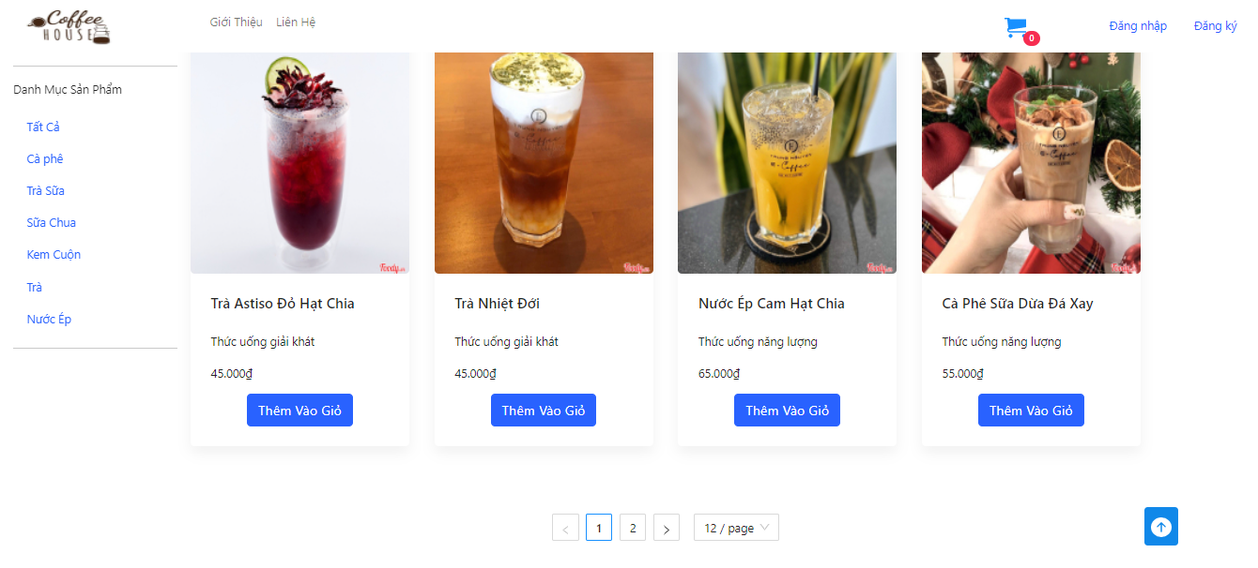
Project Overview

Slide 21
Other Soft-skills
Teamwork.
Communicate with my team’s member.
How to research a object or solve a problem.

Slide 22


Slide 23
Question & Answer?

Slide 24
Thanks for watching & listening

